Slide 1



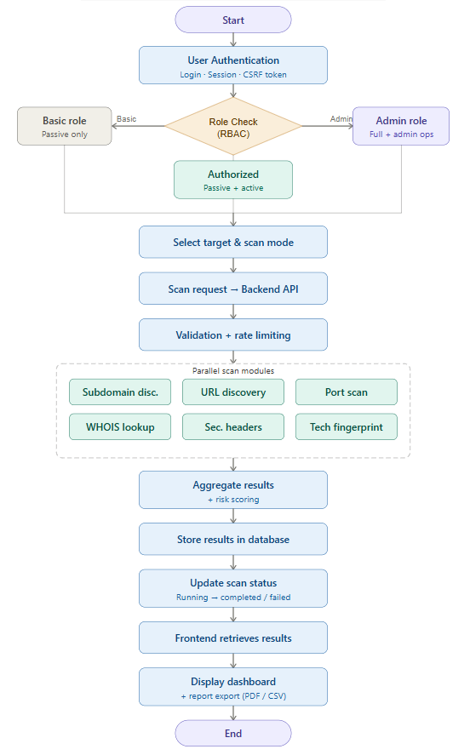
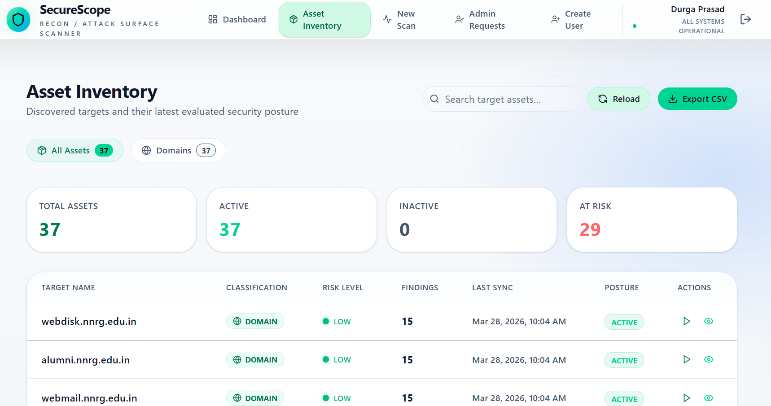
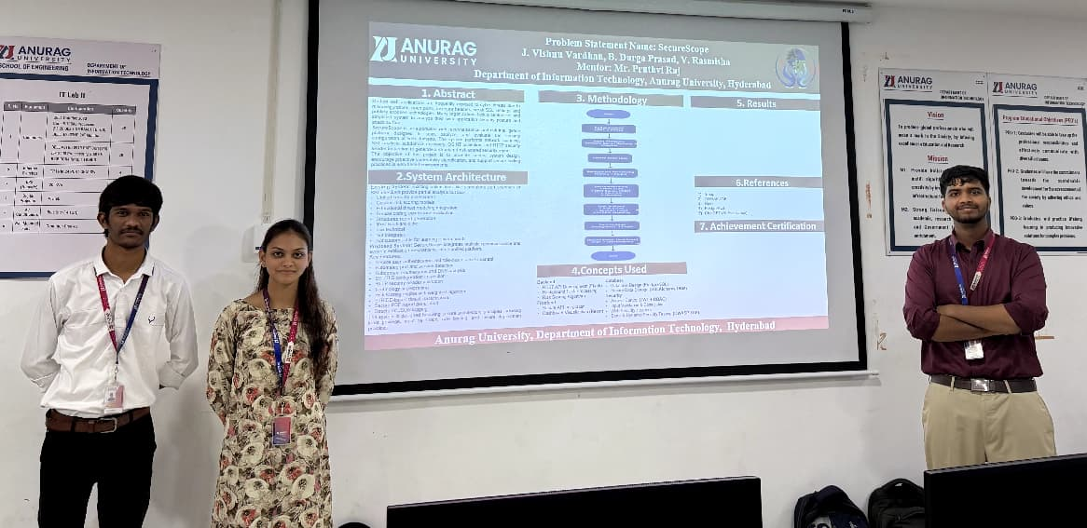
Problem Statement Name: SecureScope
J. Vishnu Vardhan, B. Durga Prasad, V. Rasmisha
Mentor: Mr. G. Sai Krishna
Department of Cyber Security, Anurag University, Hyderabad
1. Abstract
3. Methodology
5. Results
Modern web applications are vulnerable to cyber threats due to misconfigurations, insecure headers, weak SSL/TLS settings, and exposed services. Organizations often lack a unified and easy-to-use system to assess their overall security posture.
SecureScope is an automated web security and reconnaissance platform that scans, analyzes, and evaluates web applications. It performs port scanning, SSL/TLS analysis, subdomain enumeration, OSINT collection, and HTTP header inspection to generate a structured, risk-based report. The system promotes secure development practices, proactive vulnerability detection, and improved attack surface visibility.
6.References
2.System Architecture
Self – testing and Validation
Open AI Codex
OWASP ZAP
SecureScope integrates multiple security analysis and reconnaissance techniques into a centralized platform for efficient vulnerability assessment.
It enables real-time threat detection, attack surface visibility, and proactive risk mitigation for web applications.
Key Features:
Secure authentication (JWT + RBAC)
Automated port scanning & service detection
Subdomain enumeration & DNS analysis
SSL/TLS configuration assessment
HTTP security header validation
Technology fingerprinting
Risk scoring engine with STRIDE-based classification
Background task processing (Celery & Redis)
Structured logging & secure report generation (PDF)
7. Achievement Certification
4.Concepts Used
Backend
REST API Development (Flask)
Risk Scoring Algorithm
Frontend
Secure API Integration
Dashboard Visualization (React)
Database
Database Design (PostgreSQL)
Secure Data Storage
Security
Access Control (JWT + RBAC)
Input Validation & Sanitization
Web Security Headers
Static & Dynamic Security Testing (OWASP ZAP)
Anurag University, Department of Cyber Security, Hyderabad

